Slide 1
AIML CA2
Time Series
Lim Yu Yang Ian 2201874 DAAA/FT/2A/02

Slide 2
Objectives
Time Series
The goal is to develop a Time series model that can accurately predict and forecast values on consumption.
Why it’s important
Allows for better management and planning of energy resources
Planning on future development and securing of sources
Building of architecture to support future demands
Calculating future expenditure on resources

Slide 3
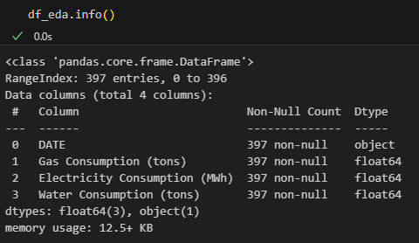
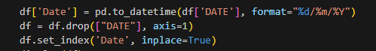
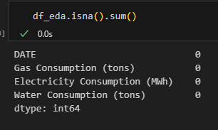
Data Observations
Date is an Object Dtype. Handling needs to be done
Above I convert the the Date format into dd/mm/yyyy format.
No Null Values, no null value handling needs to be done

Slide 4
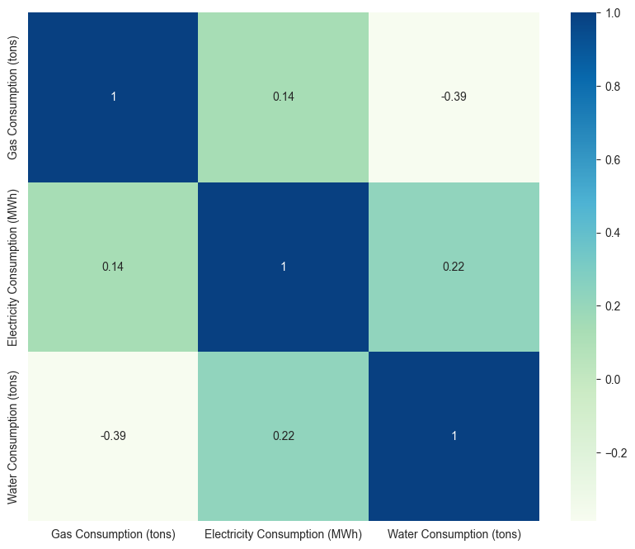
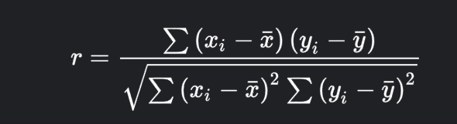
Data Observations
Pearson’s R correlation.
No high correlations between any Consumption type.

Slide 5
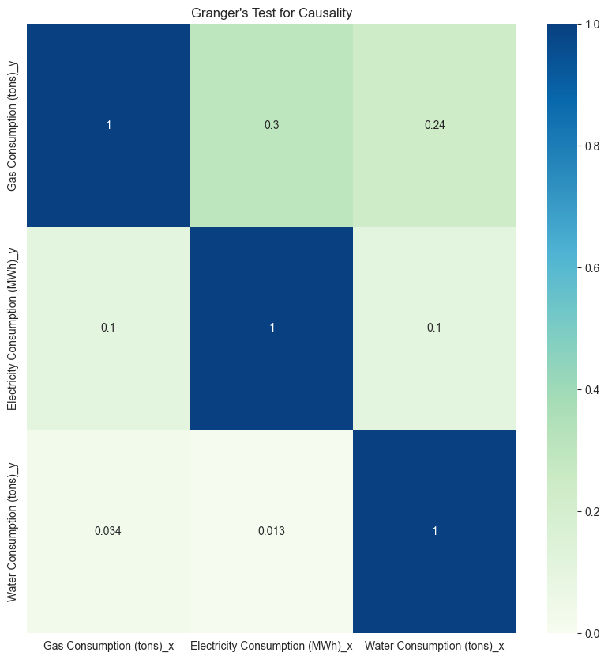
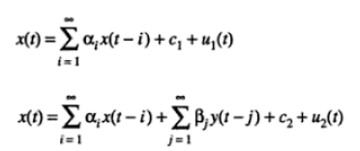
Granger’s Test for Causality
Granger’s Test allows me to assess whether one variable is dependent on another.
Water against the other consumption types produces a value less than 0.05
There is Granger’s Causal Relationship present for water.

Slide 6

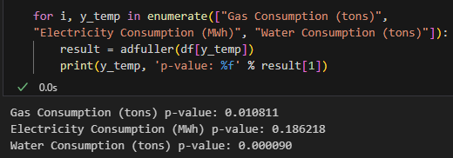
Covariance and P-Value
To get the P-values, I will be using the Augmented Dickey Fuller (ADF) Test. It determines whether a unit root is present in the time series dataset.
If p > 0.05, the dataset is non-stationary,
Otherwise the dataset is stationary
Electricity is not stationary
Differencing needs to done for electricity
The rest are stationary

Slide 7
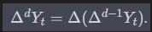
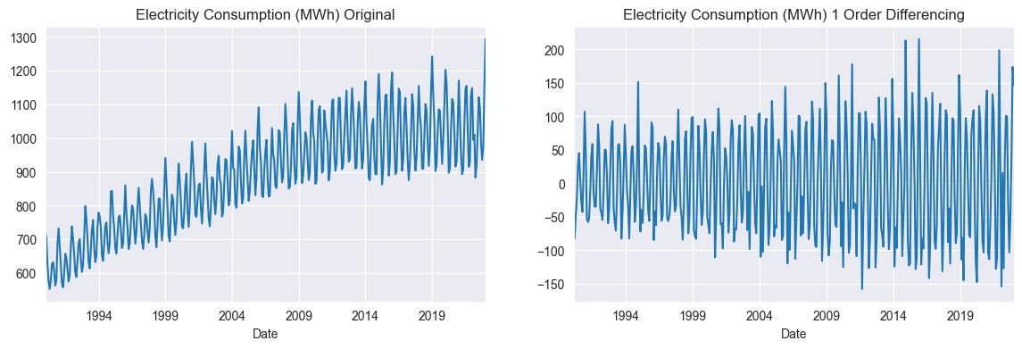

Differencing
Differencing is the process of which to stabilize the dataset.
This value will be recorded for later use in the d value of models.
We can see the before and after 1st order differencing.
P value is now < 0.05

Slide 8
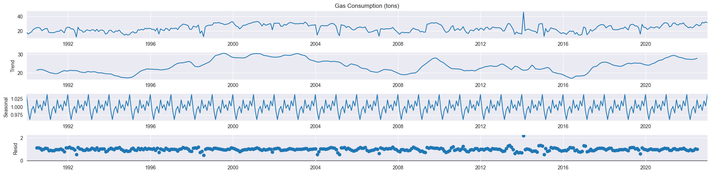
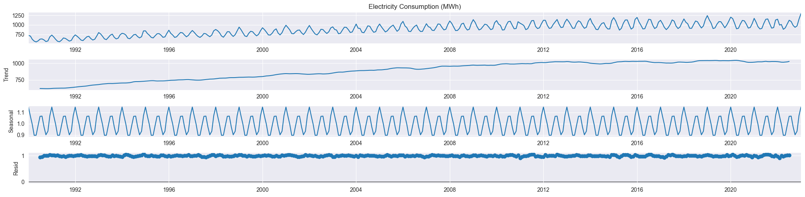
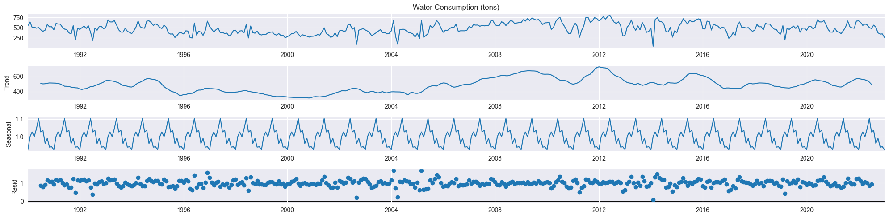
Seasonal Decomposition
Seasonality allows me to gather the trend, seasonality, and residual.
Gas:
No trend
Strong Seasonality
Electricity:
Positive linear trend
Very Strong Seasonality
Water:
No trend
Strong Seasonality
Gas
Electricity
Water

Slide 9
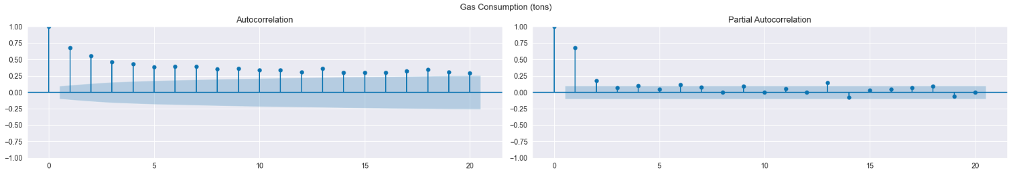
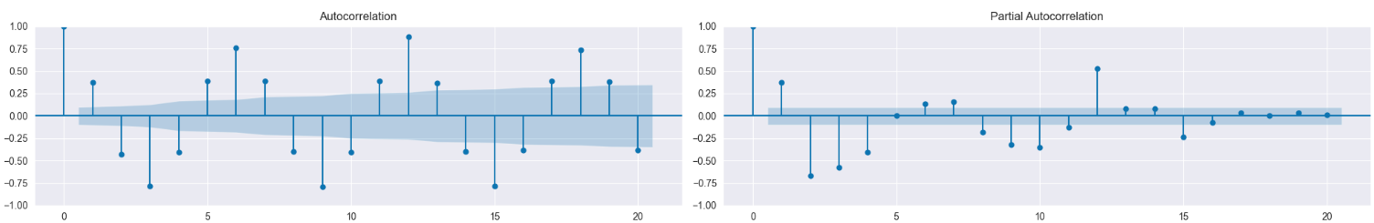
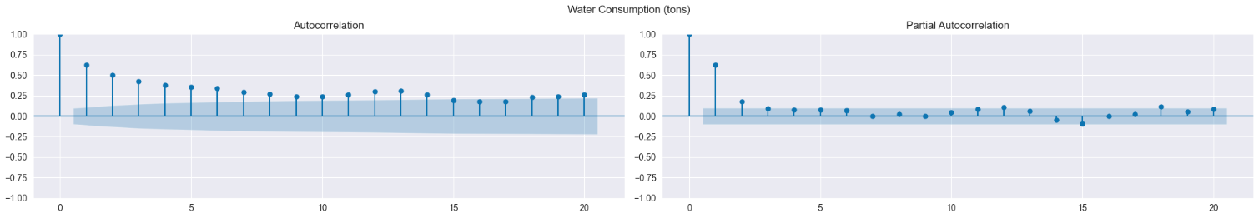
PCAF & ACF
Partial Autocorrelation Function (PCAF) & Autocorrelation Function (ACF) help to find the non-seasonal, and seasonal Autoregressive Order (p/P), and the Moving Average Order (q/Q)
ACF
PACF
Geometric Decay = GD
Gas:
GD present in ACF
PCAF most significant lag at 1
(1, 0, 0)
Electricity:
GD Sine present in ACF
PCAF shows GD Sine
(1, 1, 1)X(1, 1, 0, 12)
Water:
GD present in ACF
PCAF most significant lag at 1
(1, 0, 0)
Gas 0 order
Electricity 1st order
Water 0 order

Slide 10
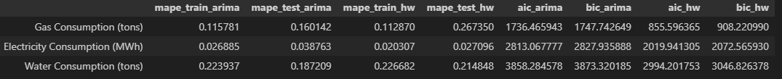
Model Evaluation
I modelled all consumption types by Holt Winters Exponential Smoothing,
and ARIMA (Gas/ Water) SARIMAX (Electricity)
Using Seasonality = 12 (data based on years)
Scoring Techniques:
MAPE: Moving Absolute Percentage Error
AIC: Akaike Information Criterion
BIC: Bayesian Information Criterion
ARIMA outperforms Holt Winters for Gas and Water
Holt Winters outperforms SARIMAX in Electricity

Slide 11
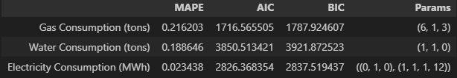
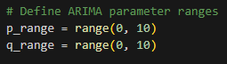
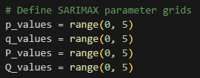
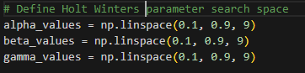
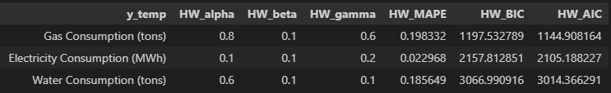
Model Hyper Tuning
Based on MAPE, AIC, and BIC, Holt Winters performed the best for all 3 consumption types.
Thus I will pick Holt Winters for all 3 consumption types as my model of preference

Slide 12
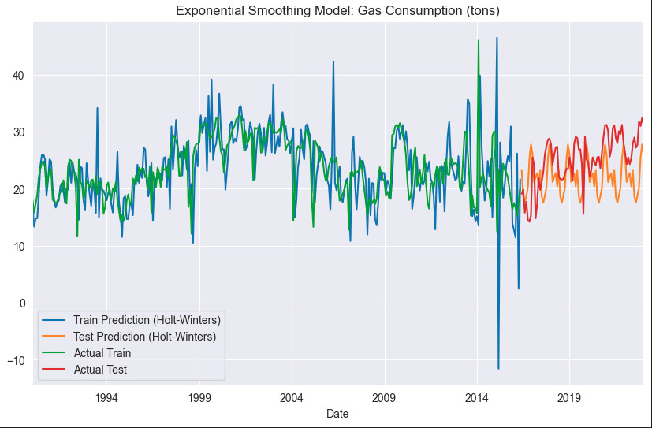
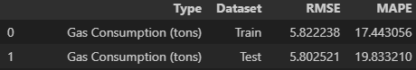
GAS
RMSE:
A test score of 5.80.
In context of the Gas Consumption data having a mean of 23, the RMSE score is decent.
MAPE:
A test score of 19.83%.
The error is 19.83%. This is an acceptable score.

Slide 13
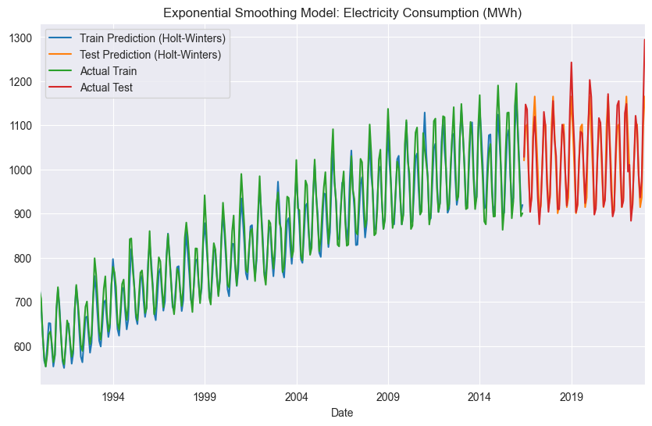

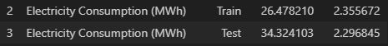
Electricity
RMSE:
A test score of 34.32.
In context of the Electricity Consumption data having a mean of 888, the RMSE score is excellent.
MAPE:
A test score of 2.30%
This is a near perfect score.

Slide 14
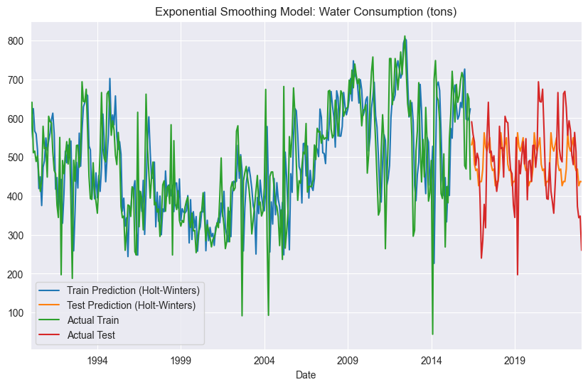

Water
RMSE:
A test score of 103.45.
n context of the Water Consumption data having a mean of 484, the RMSE score is decent.
MAPE:
A test score of 18.56%.
This is an acceptable score.

